Slide 1

Computer Ports
Ashish Subedi
Month 08/4/2024

Slide 2
Table of contents:
The upcoming slides will be described wise as given below:
Subject Page
Definition of Ports 3
Serial Ports 4
Parallel Ports 5
USB Ports 6
VGA 7
HDMI 8
Ethernet 9

Slide 3
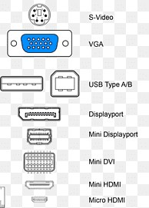
Definition of ports
Ports in computers are like channels that help different programs and devices send and receive data. Each port has a unique number to make sure the data goes to the right place.
Ports helps in connecting the external peripheral device to the motherboard to function their tasks.
Fig: Different types of ports

Slide 4
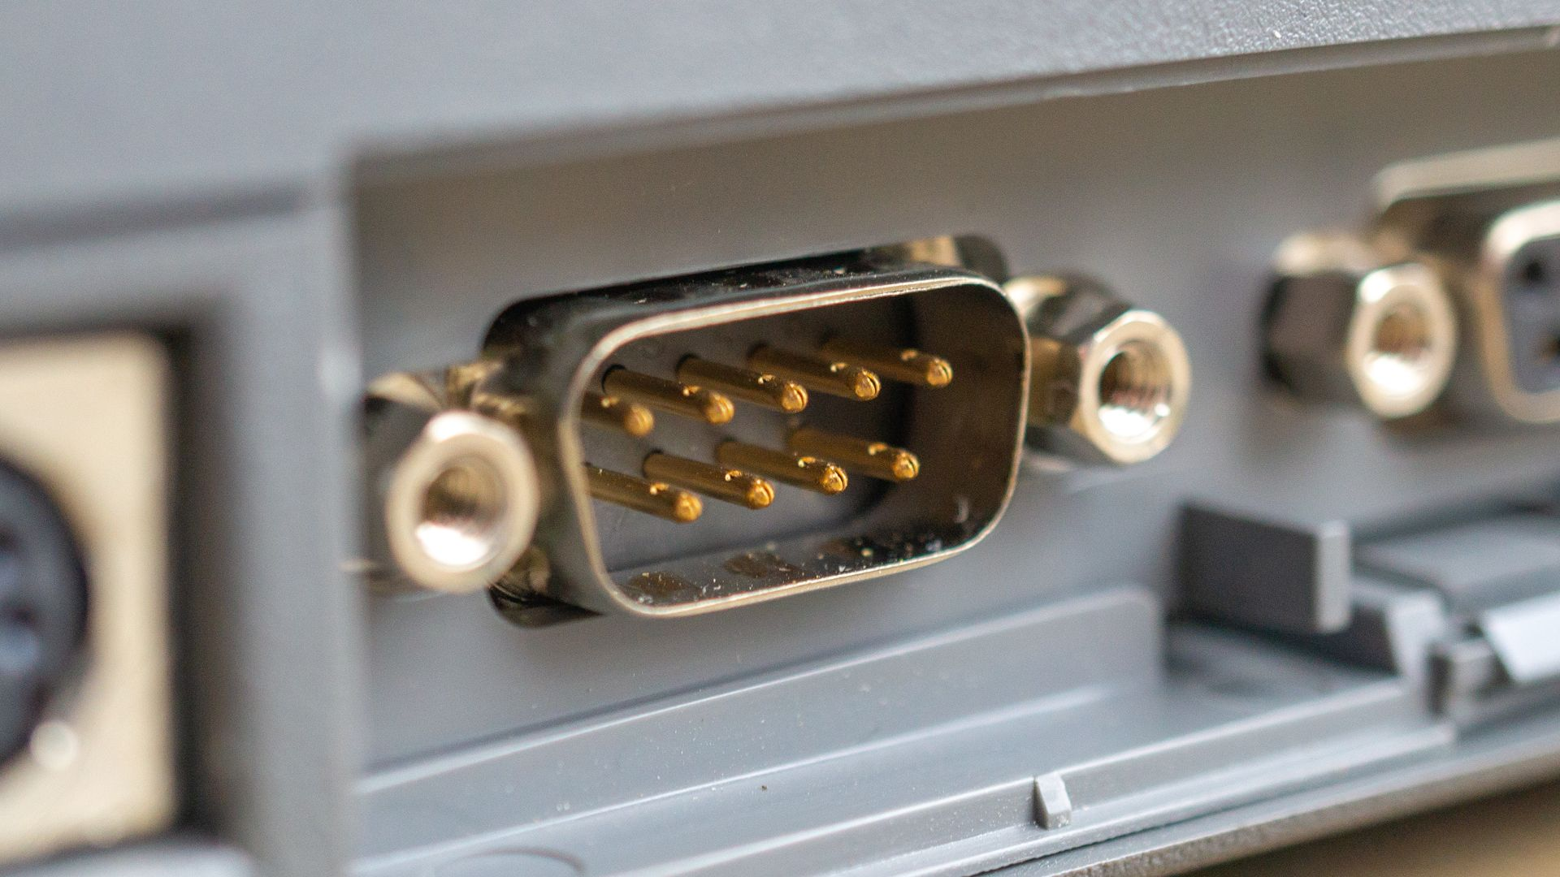
Serial ports
All about serial ports
A serial port transmits data one bit at a time over a single line, commonly used for connecting older peripherals. It uses standards like RS-232 and is less common today, having been largely replaced by USB.
Advantages:
Simplicity: Easy to set up and use for basic data transfer.
Reliability: Provides consistent performance in stable environments.
Disadvantages:
Slow Speed: Lower data transfer rates compared to modern interfaces like USB.
Limited Bandwidth: Transmits data one bit at a time, which is less efficient.
Fig: Serial port

Slide 5
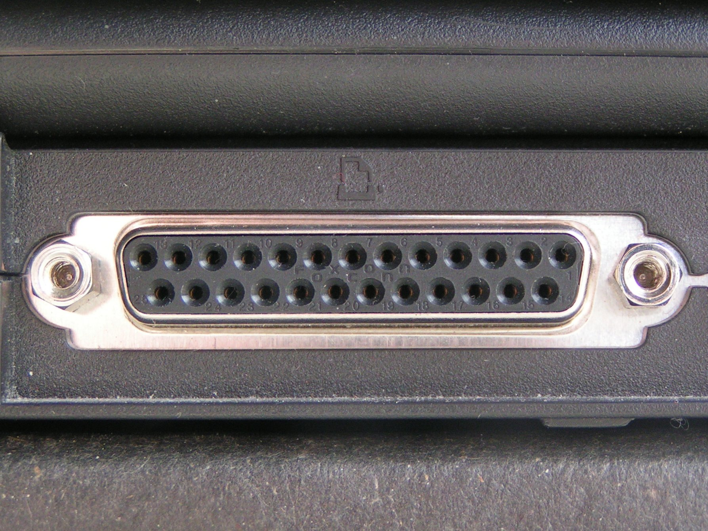
Parallel ports
All about parallel ports
A parallel port transmits multiple bits of data simultaneously over multiple lines, allowing for faster data transfer compared to serial ports. It was commonly used for connecting printers and other peripherals but is largely obsolete today.
Advantages:
Faster data sender: Sends multiple bits of data at once, providing faster communication than serial ports.
Higher bandwidth: Supports higher data transfer rates, suitable for devices like printers.
Disadvantages:
Bulkier Connectors: Uses large, cumbersome connectors, making it less convenient.
Limited Range: Effective only over short distances due to signal degradation and interference.
Fig: Parallel port

Slide 6
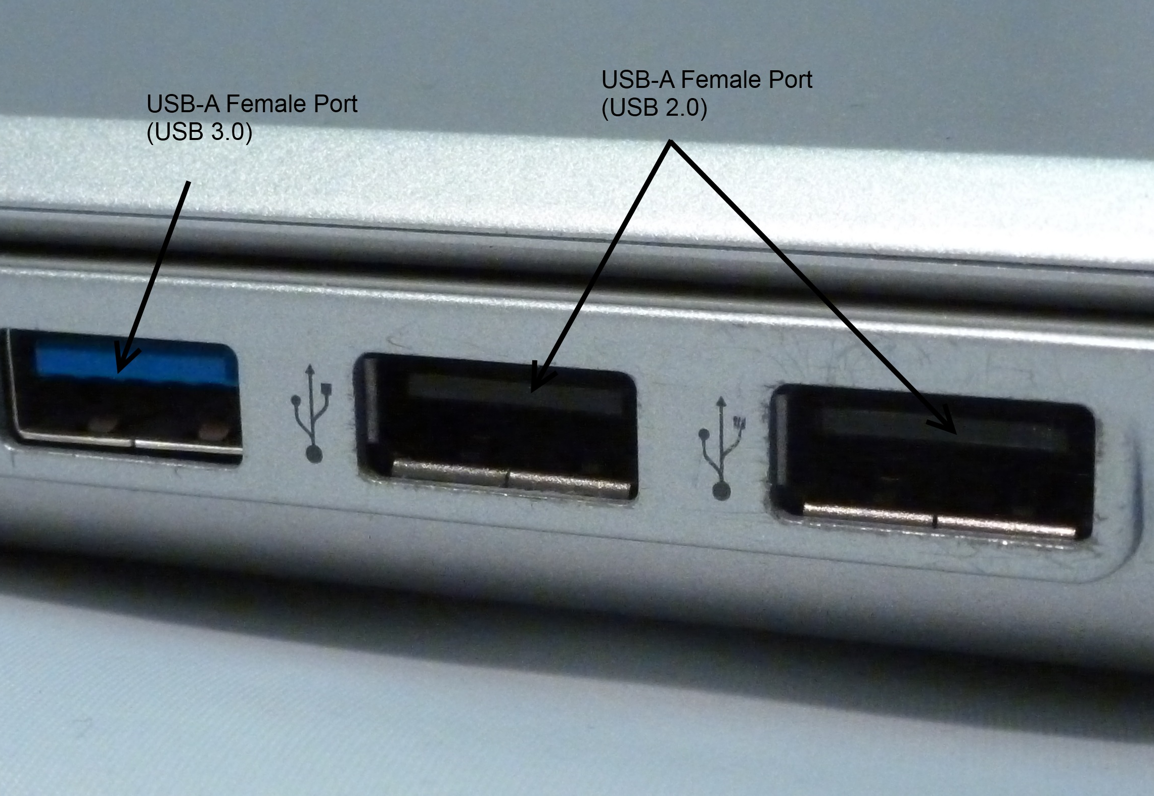
USB ports
All about USB ports
A USB port allows for fast and versatile data transfer and power supply between devices, using a standard connector for ease of use. It supports a wide range of peripherals, including keyboards, mice, storage devices, and more, making it a universal connection standard.
The Full form of USB port is: Universal System Bus.
Advantages:
High Speed: Offers fast data transfer rates, especially with newer versions like USB 3.0 and USB 3.1.
Versatility: Supports a wide range of devices, including storage, peripherals, and charging.
Disadvantages:
Compatibility Issues: Different versions and connector types can cause compatibility problems.
Cable Length Limitations: Effective over limited cable lengths, typically requiring additional hubs for longer distances.
Fig: USB port

Slide 7
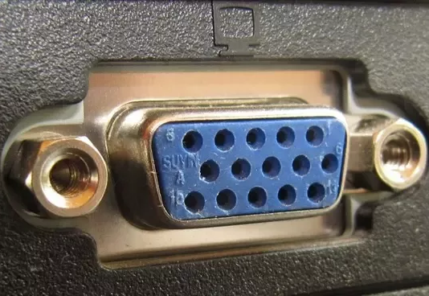
VGA ports
All about VGA ports
VGA (Video Graphics Array) is an analog video standard used to connect monitors and display devices, providing a resolution of up to 640x480 pixels. While it was widely used for video output, it has largely been replaced by digital interfaces like HDMI and DisplayPort.
Advantages:
Wide Compatibility: Works with many older monitors and projectors.
Cost-Effective: Generally less expensive than newer digital interfaces.
Disadvantages:
Analog Signal: Limited by lower resolution and signal quality compared to digital standards.
Bulkier Connector: Larger and less convenient connector compared to newer, more compact options.
Fig: VGA port

Slide 8
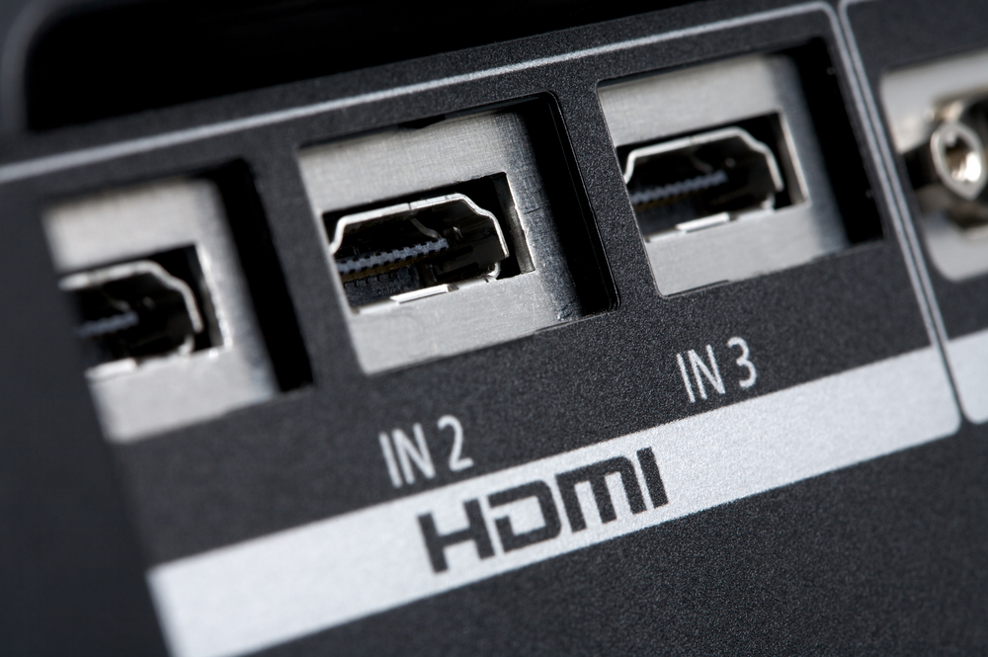
HDMI ports
All about VGA ports
HDMI (High-Definition Multimedia Interface) is a digital connection standard that transmits high-quality video and audio signals over a single cable. It is widely used for connecting modern TVs, monitors, and other multimedia devices.
Advantages:
High Quality: Supports high-definition video and multi-channel audio in one cable.
Versatility: Commonly used with TVs, monitors, and various multimedia devices, providing a universal connection.
Disadvantages:
Cable Length Limitations: Effective over shorter distances; longer cables may require signal boosters.
Compatibility Issues: Newer versions and features may not be backward compatible with older devices.
Fig: HDMI port

Slide 9
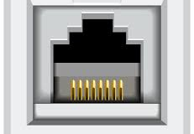
Ethernet ports
All about Ethernet ports
Ethernet cables provide stable and high-speed wired network connections for devices, supporting standards from 100 Mbps to 10 Gbps. They are crucial for reliable networking in both home and professional environments.
Advantages:
Reliable Connection: Provides a stable and consistent network connection, less prone to interference than wireless.
High Speed: Supports high-speed data transfer, ideal for fast internet and large file transfers.
Disadvantages:
Limited Mobility: Requires physical cables, restricting movement and flexibility compared to wireless connections.
Cable Management: Can be cumbersome to manage and organize, especially in complex setups.
Fig: Ethernet port

Slide 10

Thank You
Presentation by:
-Ashis Subedi
ashisvlog12@gmail.com

